Slide 1
Fivetran HVR Training
v1.3
Last updated: 18/03/25
Application Operations

Slide 2
Introduction
Intro to Application Operations
Application Operations
Job Activation
Capture & Integrate
Refresh
Compare
User Management
Change Management
HVR Job Logs
This module provides an in-depth look at the day to day management of Fivetran HVR’s replication streams from application perspective.

Slide 3
Intro to Application Operations

Slide 4







Intro to Application Operations
Channel Management
Job & Task Management
Error Troubleshooting
The creation, change, testing of HVR channels. Adding or removing tables, columns, actions. Documentation prep.
Managing CDC Jobs and Refresh Tasks based on the channel designs. Activating new, or updated channels.
Solving errors internally or with the help of Technical Support. Documenting known or recurring problems.
DQ Analysis
User Management
Performance Analysis
Ensuring that data delivered is matching the source system.
Enabling users to interact with the HVR UI, setting permissions.
Enabling the transparent reporting of Job metrics and replication performance.

Slide 5
Application Operations
Activation

Slide 6
Job Types
Capture
Integrate
Refresh
Compare
Obtaining change data from the source and landing it on the Hub in the form of transaction files.
Sorting, coalescing and integrating transaction files into the target from the Hub.
Loading tables in Bulk or by slicing them. Loading subsets of data for repair purposes.
Performing Data Quality analysis using comparison Tasks.
Created through Activate
Created through the Refresh Data dialog
Created through the Compare Data dialog

Slide 7
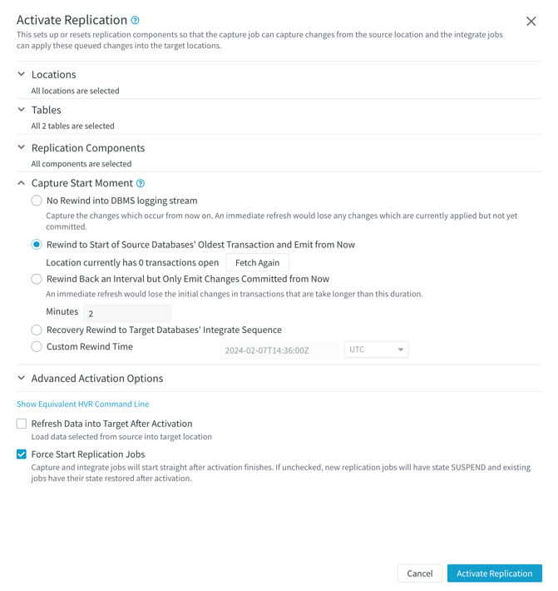
Activating Replication
Option Activate Replication allows the creation of objects needed for replication runtime.
These allow starting data replication Jobs.
The UI runs command hvractivate on CLI.
Activation options can be customized in the Activate Replication dialog.

Slide 8
Activating Replication
Select Locations and Scope of tables
Specific replication components only affect certain types of objects required for capture and integration.

Slide 9
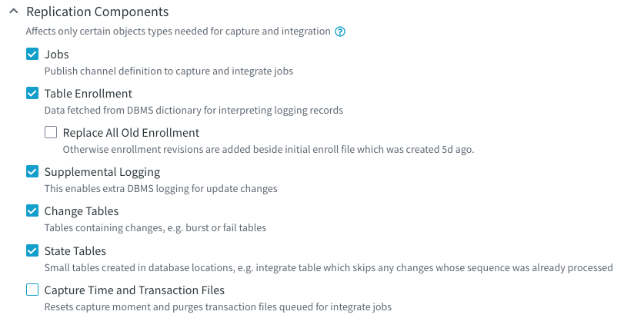
Activating Replication
Replication Components:
Jobs: Creates jobs or recreates job scripts.
Table Enrollment: Only relevant to log-based capture locations. The enroll file lists all tables, identifiers, or column information for log-based CDC. If replication exists, changes are applied as enroll revisions.
Replace All Old Enrollment: Removes all enroll files and recreates the enroll file from scratch.
Supplemental logging: Enables logging on the source tables and enables database-level logging if necessary. May require elevated privileges for the database user.
Change tables: (re)creates burst and fail tables.
State Tables: Creates state tables in the target databases. These are used to track replication so it can be accurately resumed in the event of a crash.

Slide 10
Activating Replication
Capture Start Moment is activated if the Capture Time and Transaction Files component is selected.
It always purges all transactions accumulated on the hub and repositions the capture time.
No Rewind: pick up changes from the current time
Rewind to the start of the oldest transaction: Positions the capture to the beginning of the oldest open transaction, preventing data lost on long running TXs. Not available on some DBMS types (e.g. Postgres)
Rewind back an interval: Rewinds back a certain interval. There is a risk losing data if a long running TX started before this time.
Recovery integrate sequence: Rewinds back to the last integrated change. Information is gathered from the target state table. Do not use the State Tables option with this. Only available on databases where rewind is possible.
Custom time: Rewinds back to a custom timestamp.

Slide 11
Application Operations
Capture & Integrate

Slide 12
Capture
Job Run
1
2
3
The HUB initiates the connection towards the source. If Agent is used, HVR connects to it first. An ODBC connection is opened after.
HVR runs a few initialization queries to check the default collation, timezone, version.
HVR checks the redo log destinations, number of log threads, etc. This is stored in the enroll file (*.enroll).
4
5
6
HVR then asks the database via sql where the next transaction is located. We always know the last one from the .cap_state file.
The capture job scans the logs, starting with the correct online or archive log. The tail end is read every 10th of a second. If a commit occurs, the capture re-checks again in 0.5 seconds for more commits.
HVR bundles the captured transactions, and sends them to the Hub. On the Hub, these transactions are routed to the integrate router directory.

Slide 13


Capture
Job Cycling
Capture Job
While the Capture Job runs continuously, a single loop of it is called a cycle. During cycles, Jobs re-read DBMS logging every tenth of a second.
Init
Once changes are detected, HVR starts to read them into memory. An extra wait time of 0.5s is then added and HVR re-reads for bundling, reducing the chance of micro cycles.
Cap State File
Cycle
Transaction File
The cycle only stops when all data is extracted after the commit.
Log Release File

Slide 14
Capture
Job Cycling
Capture Job
If the cycle goes on for more than 10 seconds, HVR introduces sub-cycles and writes the TX files.
Init
Jobs cycle every 10 minutes if there is no data.
Cap State File
Cycle
Transaction File
The is no wait if Action Schedule’s parameter CaptureStartTimes is defined.
Log Release File

Slide 15



Checkpointing
A feature for faster Capture recovery with long-running transactions.
without checkpointing
with checkpointing
Start of TX 1
T-45 min
Start of TX 2
T-30 min
Checkpoint Creation
T-15 min Includes TX1 and TX2.
Capture Recovery
Now
Recovery only goes back to the checkpoint, and not to the oldest TX (1)

Slide 16
Integrate
Job Cycling
Integrate Job
Integrate Jobs re-scan the router directory 4 times per sec until TX files are found. Up to 10MB of TX files are taken for Continuous Integrate. Up to 100MB are taken for Burst Integrate. (can be changed)
Init
Integrate does sorting, coalescing as needed, then sends the data to the target. The Job’s log entries are sent back to the Hub and the scheduler appends log files with them.
Cycle
Integrate State Table
Jobs cycle every 10 minutes, even if there is no data. By default the Integrate is run all the time, unless IntegrateStartTimes is defined.
Receive Stamp State Table

Slide 17
True or False? Activation with the Capture Time component removes all pending transactions from the hub.
True.

Slide 18
Application Operations
Refresh

Slide 19

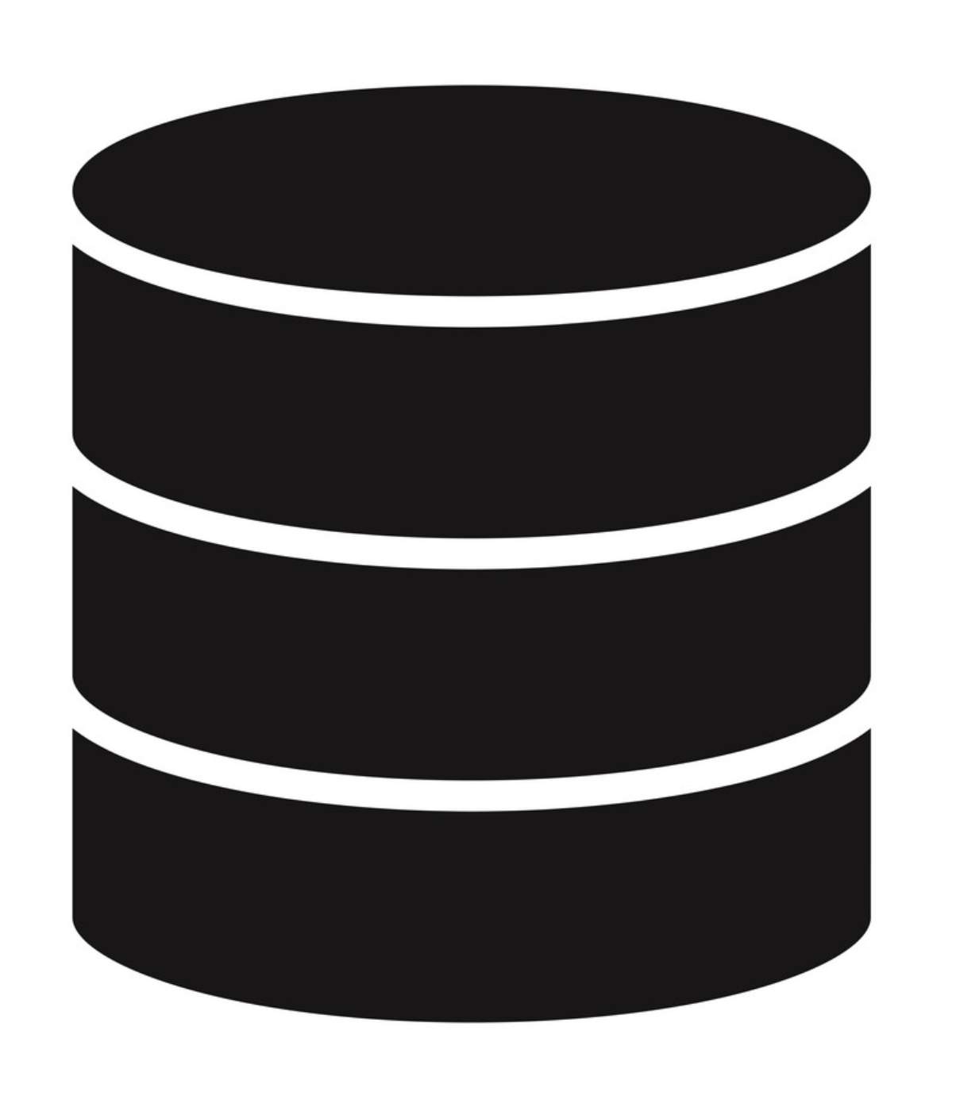




Refresh
Oracle
Repository
Snowflake
HVA Listener
HVR HUB
HVA Listener
refresh
The Refresh Data option allows you to load base data from a source to a target.
CDC must always be started by delivering base data first, and incremental data afterwards.
During Refresh, data will be selected from the base table(s) with a SQL SELECT statement in bulk, and inserted on the target with INSERT.
Alternative names: Bulk Load, Initial Load, Full Refresh, Full Load

Slide 20
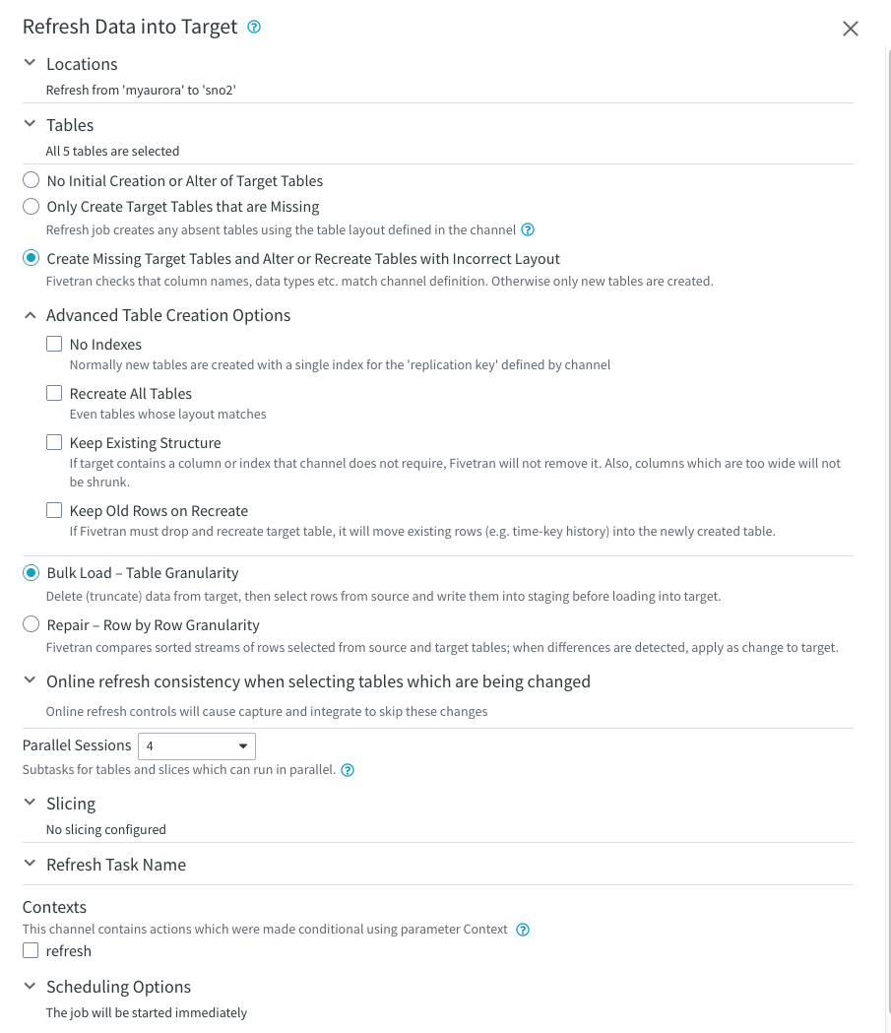
Refresh Options
The Locations section lists allows control over the source and destination locations of the Refresh Task.

Slide 21
Refresh Options
The Tables section allows the selection of tables you wish to include in the Refresh Task.
It also allows the user to control the creation or modification of tables.

Slide 22
Refresh Options
Advanced Table Creation Options:
No Indexes: HVR won’t create a unique key or non-unique index on the target table.
Recreate All Tables: force recreate target tables
Keep Existing Structure: extra columns won’t be removed, wider columns won’t be shrunk
Keep Old Rows on Recreate: creates a backup of the table before drop-recreate.

Slide 23
Refresh Options
The product offers two (+1) Refresh types:
Bulk Refresh means that the target object is truncated, and then the bulk copy is used to refresh the data from the source.
Row-by-Row Refresh, also referred to as Repair Refresh, compares data on read and write locations, produces a 'diff' result and updates each row individually as needed.
Upsert Refresh: A refresh is done using MERGE.

Slide 24
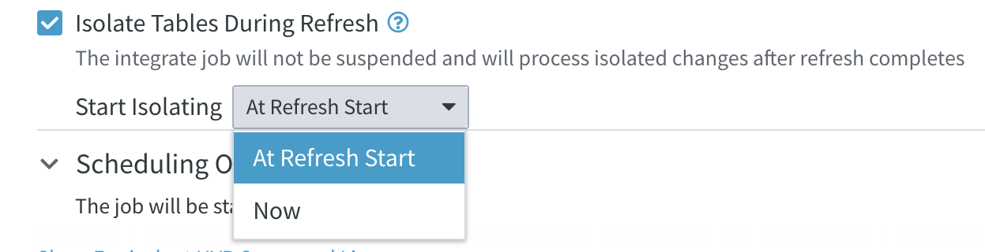
Isolated Refresh
Enable table isolation during refresh. Isolated table refresh allows integrate jobs to continue for tables that are not part of the isolated refresh. The integrate jobs for the isolated tables will resume once the refresh is complete.
Available only in 6.2.5/0 (early adopter)

Slide 25
Refresh Options
Online refresh allows proper refresh from a database that is continuously being changed.
Changes before refresh are skipped by both capture and integrate jobs
Read / Write skipping. For single cap / integ
Only integrate job skips changes before refresh
Write only. Useful for multiple integrates.
No changes are skipped, but changes before end of refresh are integrated with resiliency
No skipping. Changes that occurred before the refresh are not skipped, only special handling is activated for changes that occurred during the refresh. Useful for Restricted Refresh.

Slide 26
Refresh Options
Parallelism allows loading tables on multiple threads. Each thread works on a single table.
Tables are loaded in alphabetical order.
Slicing allows you to split tables if required.
We talk more about slicing in the next section.

Slide 27
Refresh Options
Each Refresh Task is named refr by default.
This can be changed in option Refresh Task Name.
Name must be lowercase and start with “r”.
The name has a limit of 8 characters.
It is important to name Refresh Tasks, otherwise the task script will be overwritten.
Choose from contexts to control what actions are used for the Refresh Task.
Task Scheduling Options can be set in the Scheduling Options submenu.

Slide 28




Types of built-in Slicing
Great for large tables.
Modulo
Count
Boundary
Series
A modulo operation is performed on the numeric column you choose. HVR sorts rows by the remainder. Do not use more than 10 slices. Results in a full table scan (!)
A type of advanced modulo slicing, for columns with non numeric data.
Requires a custom Environment variable.
Requires a column with the known range of possible values. Beneficial on partitioned tables by slicing on the partition column.
An advanced option of Boundary Slicing, that groups the data set on a column value.
Requires a column with a small set of unique values.

Slide 29
Custom Slicing
Great for large tables with special needs.
Use Restrict
Use HVR_VAR
Use Context
Combine Context
Create custom slicing options by using a Restrict action, instead of the built-in methods. You may have to cast the datatype or do something unique.
Specify a custom variable that you can set while creating a Refresh Task.
Use a Context name so that your action is not always active. Others may run refresh jobs without knowing about your Restrict.
Combine multiple Actions using the same Context name. Example: specify a custom condition, while also setting table names.

Slide 30
Demo
How to use custom slicing?

Slide 31


Refresh
Considerations
Test Thread Count
Know the number of Refresh task threads your Source database can take.
It is good practice to start with a max. of 5 threads.
Name the Task
Do not forget to name the Job Task. The name must start with an “r”. You stop a running task if you create a new one without specifying a name.
Know your Tables
Be mindful of the size of tables you add to a task. The largest table will keep your job running, even if smaller tables have already been loaded.
Aaand it’s gone
Note that Refresh tasks run a TRUNCATE operation on the target table as a first step by default. This can be prevented with a Restrict condition on the target or by using the merge option.

Slide 32

Refresh
Problems
The job times out while running a single threaded refresh on one or more large tables.
Running a Refresh with the wrong Online option.
Running into incorrect data, or data that cannot fit into target datatype(s).
During Refresh with Restrict, the SQL syntax for the restriction is only valid on one endpoint.

Slide 33
If a Refresh task fails, the target table will be left empty and the Integrate Job will stay suspended.

Slide 34

Timeline of Channel Activation
When enabling CDC, the proper timeline of Jobs is important.
If the timeline is not followed, data gaps may occur.
Start of Capture
Activating capture by rolling it back to oldest open transaction, then starting the job.
Start of Refresh
Creating a Refresh Task to pull base table data out of the source. If this is the first time these tables are replicated, tables should also be created.
Refresh Completion
At this point, all tables have been created and the base data for all of them has been loaded to the target.
Start of Integrate
Once Integrate is started, the first Cycle will include changes that occurred during Refresh. These are integrated with resiliency.

Slide 35
True or False? To avoid data loss, initial load should be started before capture job activation.
False.
The capture job should be initiated first.

Slide 36
True or False? Users can use custom filter conditions in refresh.
True.

Slide 37
Application Operations
Compare

Slide 38
Compare
Oracle
Repository
Snowflake
HVA Listener
HVR HUB
HVA Listener
compare
The Compare Data option allows you to compare data between a source to a target.
Online Compare was designed for one-way replication, hence not recommended for bi-directional setups.
During Compare, data will be selected from the base table(s) with a SQL SELECT statement on both source and target

Slide 39
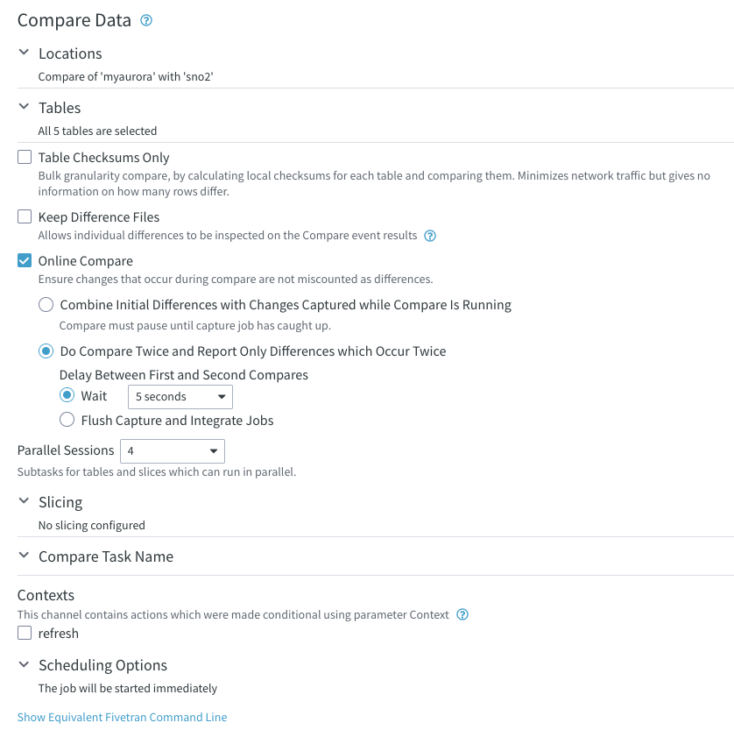
Compare Options
The Locations section lists allows control over the source and destination locations of the Compare Task.
The Tables section allows the selection of tables you wish to include in the Compare Task.
Table Checksums Only: generates a checksum of the table on both sides. If the values are different then it means there is a difference in at least one row.

Slide 40
Compare Options
Keep Difference Files: The differences are stored in $HVR_CONFIG/hubs/{hub}/channels/{channel}/locs/{tgt_loc}/diff/ and can also be downloaded from the UI. We will talk more about the diff files later. This option switches to Table Row Counts Only if Table Checksums Only is selected. In this case, HVR only counts the number of rows on both sides.

Slide 41
Compare Options
Online Compare: Does not report in-flight transactions as differences if latency is low.
Combine Initial Differences with Change Captured (also known as cap_diff) : HVR initiates the capture of changes into a separate folder and considers them to eliminate false discrepancies.
Do Compare Twice (also known as diff_diff): HVR performs two compares with a delay in between. It reports records that are different in both compares.

Slide 42
Compare Options
Slicing allows you to split tables if required. Slicing works in the same manner as in Refresh Tasks.
Each Compare Task is named “cmp” by default. This can be changed in option Compare Task Name.
It is important to name Compare Tasks, otherwise the default task script will be overwritten.
Task Scheduling Options can be set in the Scheduling Options submenu.

Slide 43
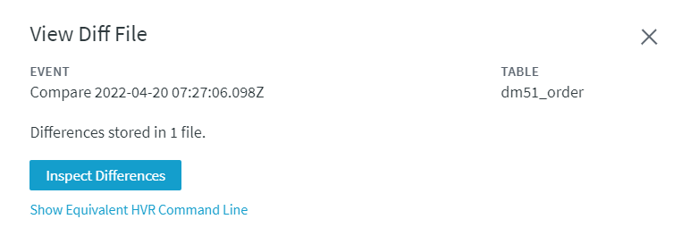
How to analyze differences
The diff file is generated when Option Keep Difference Files is enabled during a repair refresh or online compare. To view the diff file on the user interface:
On the left sidebar, click EVENTS.
On the Events page, click the required compare event to expand the event details.
Click the View Results button. This will open the Event Details page related to the compare or refresh event.
On the Event Details page, navigate to the Results pane and click View file in the DIFF FILE column. This will open the View Diff File dialog.
In the View Diff File dialog, click Inspect Differences.
To view the diff file in CLI, click Show Equivalent Fivetran Command Line and copy the command to the clipboard, then run this command in the Fivetran CLI to view the diff file.

Slide 44
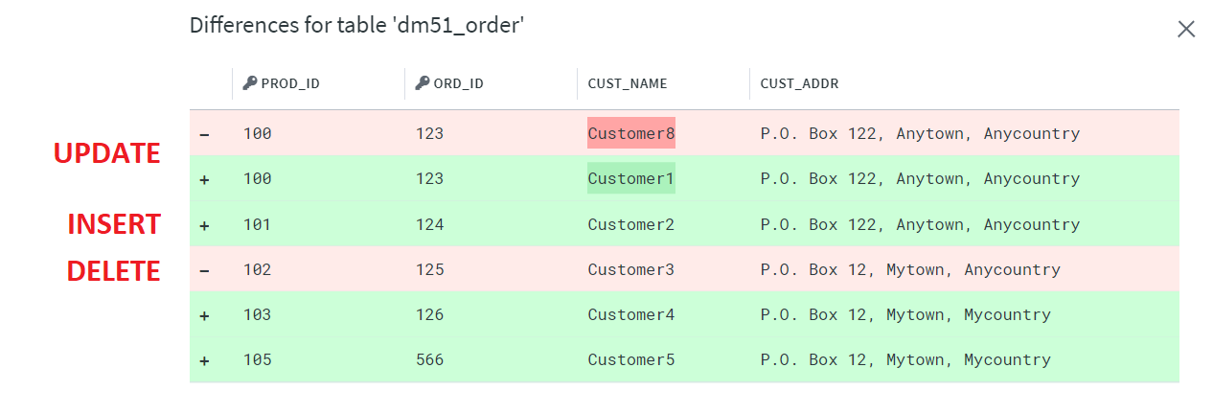
Interpreting Diff File in UI
Each row in the Diff File Viewer identifies a DML operation to be applied (or already applied in case of refresh) against a target location to bring it in sync with the source.
The Update operation is represented by a pair of lines having the same key value. The upper pink line starts with a minus (-) symbol and identifies the existing row on target, which is out of sync. The lower green line starts with a plus (+) symbol and identifies the existing row on the source to update the target row.
The Insert operation is represented by one green line starting with a plus (+) symbol.
The Delete operation is represented by one pink line starting with a minus (-) symbol.

Slide 45
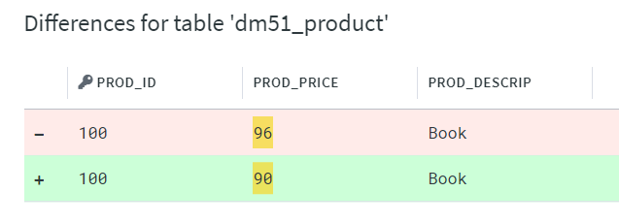
Inconclusive Differences
Inconclusive differences can only be detected during the diff_diff online compare.
It means that during a first compare operation, one kind of difference is detected and during the second compare operation, a different one is detected in the same row.
The inconclusive difference is highlighted in yellow.
Example: During the first compare, the value on the source was 90, the value on target was not 90, but also was not 96. Then, in the second compare, the source still has 90, but the target has 96 this time.

Slide 46
True or False? Online compare uses more resources than bulk compare.
True.

Slide 47
True or False? In-flight transactions are not reported as differences in bulk compare
False.
Changes in the pipeline are considered only in online compare.

Slide 48
Application Operations
User & Change Management

Slide 49
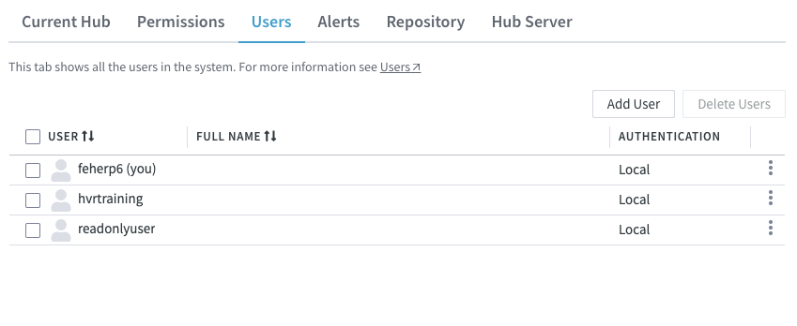
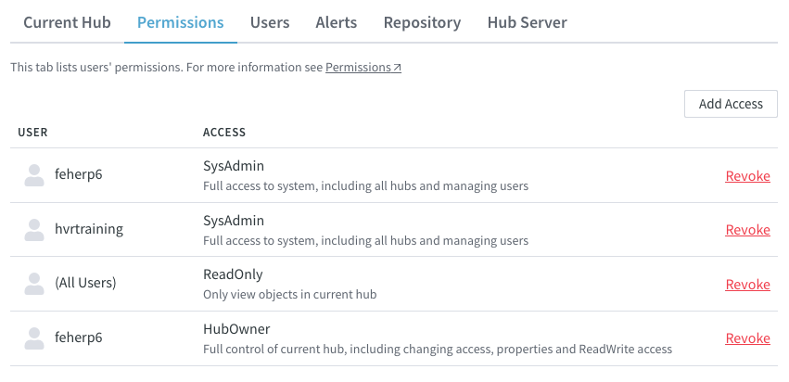
User Management
Users with HubOwner or SysAdmin privilege can manage other user accounts on the UI.
Adding new users (the default role is defined during hub creation or can be changed later in the hub properties)
Reset password of existing users
Change the users’ UI preferences (dark mode, amount of displayed events, etc.)
Assign and revoke roles

Slide 50




Change Management
Tracking User Activity
Definition Changes
Change Propagation
User activity can be tracked in the Events History page or in the metadata database.
Definition Changes can be reverted, but Activations or Refresh Tasks can not.
Changes can be propagated from an environment to another by export-importing definitions.
Definition Exports
Password Redaction
CLI & REST API
You can create static exports of entire Hub, more limited Channel, Location, and even Table Definition metadata.
Passwords in export files can be redacted.
They can also be encrypted with a transport key, or exported as is - with obfuscation or encryption if the wallet is enabled.
Export and import can also be performed through the CLI and REST API. Ops teams can leverage automation practices.

Slide 51
Application Operations
HVR Job Logs

Slide 52
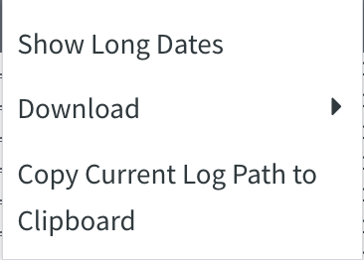
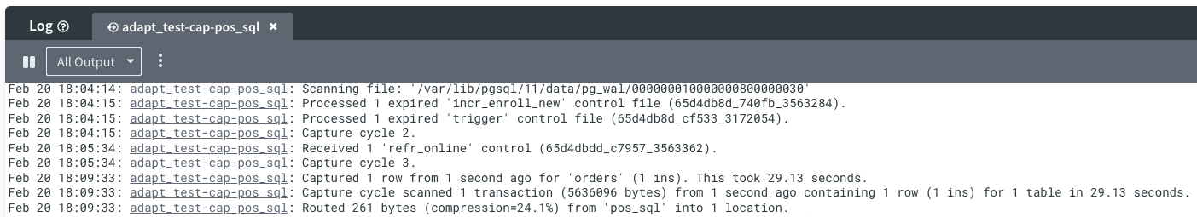
Name of the job (and logfile).
The ability to show dates in long format.
Download log file snippets.
Moment of log entry.
Job progression, including information about all captured transactions and time the event took.

Slide 53
Demo
How to read and interpret HVR log files?

Slide 54
Key Learnings
1
Talked about Application Operations in general.
Mastered channel activation and job creation.
Learned about the way Capture and Integrate jobs work and the type of logs they produce.
Tailored Refresh and Compare for specific needs.
Learned about user and permission Management.
Looked at HVR's change management features.
2
3
4
5
6

Slide 55
Q&A

